Slide 1

Session 13
Steps 3.1 & 3.2
Develop Objectives, Indicators and targets
Essential EAFm training
Date |Place

Slide 2
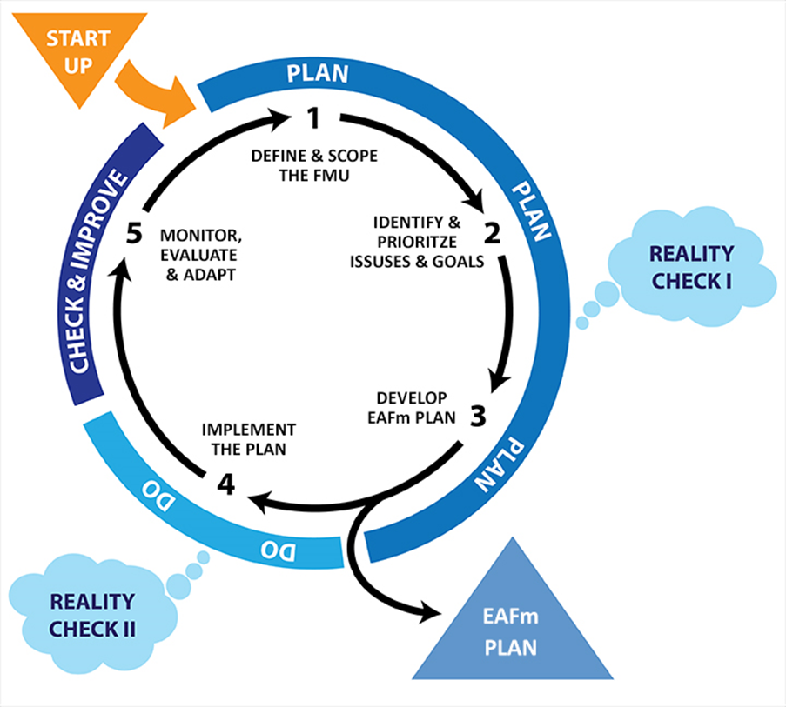

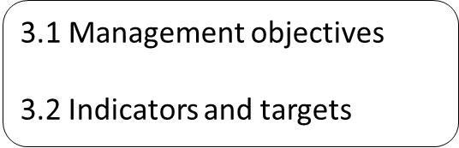
Notes:
We are now at Step 3. This step has 5 sub-steps. In this module we will look at 3 (i) develop management objectives, (iii) develop indicators and targets.
Refer to large flipchart of this on wall to keep up as reference throughout course. Show where we are in course.

Slide 3
Session Objectives
After this session you will be able to:
Develop management objectives
Develop indicators and targets related to the objectives
Notes:
Self explanatory

Slide 4
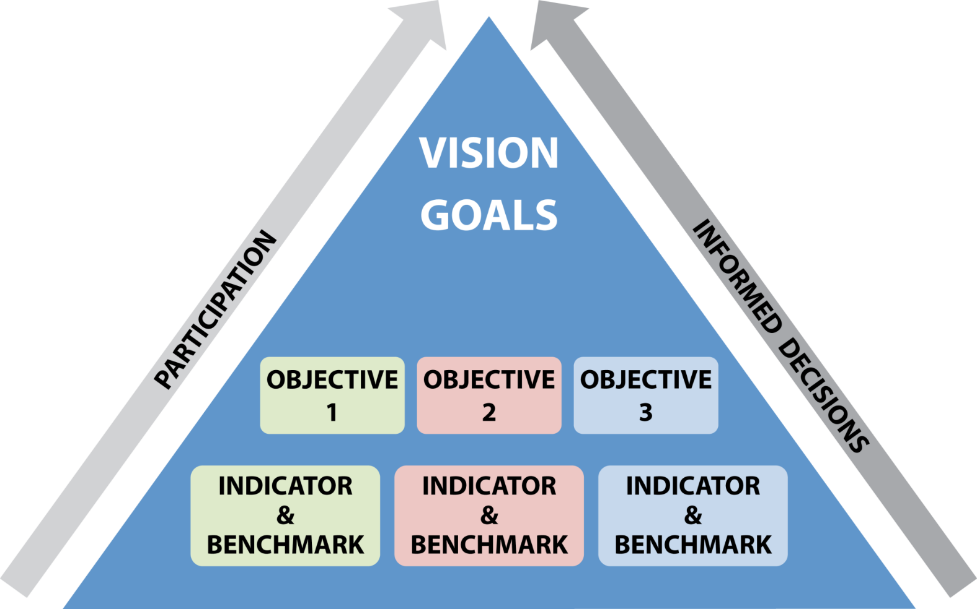
Building the EAFm Plan
Notes:
We have already developed the VISION and GOALS.
The next step is to add OBJECTIVES, INDICATORS & BENCHMARKS.

Slide 5
3.1 Developing Objectives
Priority problem (core problem)
Management
objective
Ask:
For this problem: what do you
want to achieve?
Notes:
LINK Issue to the objective. If you have carried out a problem tree analysis, it is usually the effect that become the objective.
Remind participants that you develop objectives IN CONSULTATION with all possible stakeholders (refer to various stakeholder meetings/ workshops) as explained in Startup B. This process will end up with having multiple objectives.

Slide 6
Objectives
What you want to achieve!
Achievable through management actions
Management objective
Management Objective = e.g. Reduce the % of juvenile fish that are caught
Management Objective = e.g. Improve the health of the ecosystem
Notes:
Step 3.1 The objective should be a way of achieving the agreed FMU goal (agreed in step 2.3). An objective is a formal statement detailing the desired outcome of management.
Need some examples of good and bad objectives. Bad objective because it is something that you can not manage through action. Trainer must have thought of some related to specific FMU issues that have come up before lunch.
Good objective = clear and specific. Bad objective = too broad, ‘health’ not defined, ‘ecosystem’ not defined.

Slide 7
3.2 What is an Indicator?
A measure of the current status at one point in time
  e.g. temperature, number of fish, area of conservation zone
An indicator must be linked to the objective
Notes:
INDICATORS – Measure of where you currently are
BENCHMARK – What you compare the indicator with to inform how well you are meeting the objective
Indicators should be linked to the objective. Very often indicators are developed and data collected without considering what they can be used for and what they are to be compared against

Slide 8
Ecological (Fishery) Example
Goal
Fish stock abundance increased
Objective
Indicator
% of juvenile fish caught in the fishery reduced
% of juvenile fish caught by boats, or in catch landed
Notes:
You have 1 goal, then there can be various objectives, each with related indicator. Elicit from participants examples of other objectives and possible indicator for this goal.

Slide 9
Ecological (non fish) Example
Goal
Quality of riparian habitat and breeding grounds restored
Objective
Indicator
The amount of critical habitat is increased, to reduce siltation and improve breeding areas
Area of habitat recovered; Area of non-seining, or conservation areas established by co-management groups
Notes:
You have 1 goal, then there can be various objectives, each with related indicator. Elicit from participants examples of other objectives and possible indicator for this goal.

Slide 10
Ecological (non fish) Example
Goal
Vulnerable and endangered species protected
Objective
Indicator
Mortality of water birds caught in fishing gear is reduced
Number of dead birds (based on sample)
Notes:
You have 1 goal, then there can be various objectives, each with related indicator. Elicit from participants examples of other objectives and possible indicator for this goal.

Slide 11
Social Example
Goal
Objective
Indicator
Fishing households have improved livelihoods
Incomes for fishers and fish workers increased
Number fish workers employed full time in the harvest/post-harvest
Notes:
You have 1 goal, then there can be various objectives, each with related indicator. Elicit from participants examples of other objectives and possible indicator for this goal.

Slide 12
Social Example
Goal
Objective
Indicator
Fishing households have improved livelihoods
Credit and savings programmes established
Number fish workers employed full time in the harvest/post-harvest
Notes:
You have 1 goal, then there can be various objectives, each with related indicator. Elicit from participants examples of other objectives and possible indicator for this goal.

Slide 13
Governance Example
Goal
Objective
Indicator
Improve compliance with FA and DOF rules and regulations
Strengthened Fishers Associations and Beach Village Committees (BVC)
Reports from FAs and BVCs indicate reduction in illegal fishing and non-compliant activity
Notes:
You have 1 goal, then there can be various objectives, each with related indicator. Elicit from participants examples of other objectives and possible indicator for this goal.

Slide 14
Setting targets and limits for indicators
A baseline (or limit) and a target, provides a way to measure the change in an indicator
  Baseline = where you are now, or have come from
  Target = where you want to be
  Limit = where you do not want to be
  e.g.
  Baseline: Undamaged riparian area of in 1980
Target: Increase the area of conservation zones by 20%, by 2020
Limit: Not to allow for a decrease in area below 50% of Baseline
 When an indicator is compared to the target and limit, it tells you how well you are meeting the objective
14
Notes:
A target, limit, or baseline that provides a reference for comparing the indicator
Target = where you want to be
Limit = where you do not want to be
Baseline = where you have come from

Slide 15

Simple Example
Objective:
  Cure the infection in a sick patient
Indicator:
  The patient’s body temperature
Target (in this example, a target):
  37 degrees Celsius in 2 days
Notes:
In this simple example, the objective is to reduce an infection. The indicator is the patient’s body temperature and the benchmark is 37 degrees Celsius. NOTE: You can combine the indicator and target into one statement of the objective e.g. “Reduce the fever of a sick patient to 37 degrees in 2 days”.

Slide 16
Example target & limit: Riparian habitat area
Establishment of conservation areas under EAFm plan
Indicator measure
Increasing beach seine nets
Target line
Area of good quality riparian habitat
Limit line
Time (year)
Notes:
This is another example but in this case we have plotted it as a time line. The indicator – riparian habitat areas is plotted over time. At the beginning, before the gears were used, the indicator was above both the limit and target (and in the green). After several years, when the destructive gear started to be used widely, the indicator has dropped below the target (into orange). EAFm plan started at this time with the establishment of the conservation /no gear areas. Eventually the indicator increases to be above the target (in the green again). Fortunately, in this example the indicator did not drop below the limit.
Refer to Participant Handbook Module 13, Figure 13.1.

Slide 17
Data & Information for Indicators & Targets
Data & information are needed for the indicators & tagets
Use existing data, where available
Collect new data, if necessary
Use participatory approaches, if possible
Note: ‘Data & information’ is a cross-cutting theme. It was needed for scoping to set the background and now is needed for indicators and their targets and limits
Notes:
Determine which data is needed to report on agreed indicators. Ensure you are collecting data on all 3 EAFm components. Use existing data (either from your own fishery/ organisation; or find out through collaboration if the data you require is already being collected by others, to avoid duplication of resources.) Tie method selection to available resources (revise design or find additional resources.) Choose methods that involve key stakeholders.

Slide 18
Indicators and Targets must be “SMART”…
Specific (in terms of quantity, quality and time)
Measurable (easy to measure with acceptable cost)
Available (from existing sources or with reasonable extra effort)
Relevant (to objectives and sensitive to change)
Timely (Information is up-to-date)
Notes:
SMART is a common acronym for indicators and targets/limits. Participants must know these. A also stands for ‘achievable’.

Slide 19
Key Data and Information Questions
What: what needs to be measured?
Who: who will measure it/them?
Where: where will the data come from?
How: how will you collect the data?
Notes:
Elaborate as much as needed and link to Start Up B and participation issues, Principles (information needs) as well as Step 1.3 scoping (data collected acts as baseline): explain how greater involvement of stakeholders in monitoring/ evaluating interventions (Step 5.1) can lead to greater ownership= motivation/ sustainability.

Slide 20
Involving Stakeholders (Participatory M&E)
Stakeholders can be involved in:
  developing the indicators and targets
  collecting data
  deciding on the methods to use
Indicators developed locally have more relevance
Notes:
Link to increased participation as EAFm Principle # 3. Explain how greater involvement of stakeholders in monitoring/ evaluating interventions (Step 5.1) can lead to greater ownership= motivation/ sustainability. Stakeholders can decide their own indicators (measures of ‘well being’ and ‘improved livelihoods’ are culturally and socially specific, they encompass more than purely economic unit of income).
Challenge: who has selected indicators you are currently using? Could other stakeholders have been involved? What can you change as part of EAFm process- i.e. be more inclusive?
Challenges: what do we mean by well-being?

Slide 21
EAFm Plan Outline
We have now finished 1st part of Step 3.
We can use the results in the EAFM plan
EAFm Management Plan for FMU XX
  Vision (Step 1)
  Background (Step 1)
  Major threats and issues (Step 2)
  Goals (Step 2)
  Objectives, indicators and targets (Step 3)
Notes:
We have now finished step 3 and we can now write Section 3 & 4 of the EAFm Plan.

Slide 22
Key Messages
In Step 3.1-3.2:
Management objectives are developed. This involves agreeing on what is to be achieved for each high-priority issue
Objectives are paired with indicators and targets to be able to assess whether the objective is being achieved
Notes:
Self explanatory.

Slide 23
VISION
Goal
Goal
Goal
Objective
Objective
Objective
Objective
Indicator
Indicator
Indicator
Indicator
Target-limits
Target-limits
Target-limits
Target-limits
Notes:
Now groups DO steps 3.3 and 3.4. This is an image of the output of the next group activity.

Slide 24
In your groups
Choose 4 core problem/causes that were categorized as hi/hi (2 ecological (1 fish & 1 environmental)); (1 human & 1 governance).
Develop a management objective for each core problem
Select indicator(s) and target(s)/limit(s) for each management objective
Core problem/cause:
Objective:
Indicator:
Target:
Limit:
Notes:
See Session Plan for activity details. Groups must develop outputs related to all 3 EAFm components. All group outputs need to be recorded in participant Workbooks.
1. Participants work in their FMU groups to develop objectives from their categorised and prioritised issues. Use different coloured cards. Ensure participants develop objectives for at least four issues that were categorized as hi/hi (two ecological (one fish &one environmental)); (one human &one governance).
They will already have some objectives, so no need to start from scratch.
2. They also agree indicators and benchmarks for their FMU objectives. They will already have some indicators, so no need to start from scratch.
Think about: conflict of interest/outcomes: how and who will you prioritise?
NB. remember to include those stakeholders who do NOT have a voice (given social norms, etc.): poor, women, ethnic groups/ other? Ensure you develop objectives from their perspective.
Challenge: who has selected indicators you are currently using? Could other stakeholders have been involved? What can you change as part of EAFm process, i.e. be more inclusive?
Challenges: what do we mean by wellbeing?
They must develop outputs relating to all three EAFm components.
3.Share group outputs, discuss plenary
Trainer can refer participants to Technical Toolkit 30, 31, 32 for examples of objectives and indicators (these are marine examples).

